Slide 1

BlackBerry10
A Case study
Han Yan, Minhui Gu, Sen Yang, Aruna Cheruvu, Priyanka Kalangutkar

Slide 2


Blackberry
Founded in 1984 by Mike Lazaridis.
Originally known as Research In Motion (RIM)
Headquartered in Waterloo, Ontario, Canada
Best known for it’s BlackBerry phones.

Slide 3
BlackBerry OS
First BlackBerry OS launched in 1999 (v 1.0)
v 3.6 released in March 2002 for 5810.
v 5.0 released in August 2008 with Bold 9000.
v 6.0 released in Q3 2010.
v 6.1 (BB OS 7) launched in May 2011.
BB OS 10 launched in January 2013.

Slide 4
Performance History
BlackBerry 850 pager could receive push email from Microsoft Exchange server using BlackBerry Enterprise Server.
Incorporation of encryption and S/MIME made it popular among government and businesses.
BlackBerry Pearl 8100 included multimedia features such as camera making it successful.

Slide 5
Awards and Accolades
Named one of ‘Canada’s top 100 employers’ by Mediacorp Canada Inc. in October 2008.
Increased global presence by opening new R&D facilities in North Sydney and New South Wales, Australia in February 2009.
Named ‘Fastest Growing Company’ (84% growth in profits despite recession) by Fortune in August 2009.

Slide 6
Decline
Introduction of Apple iPhone prompted RIM to launch a touchscreen smartphone in 2008 which was a failure.
Over the years RIM 's BlackBerry had lost market share worldwide to Apple's iPhone and to smartphones running Google's Android operating system.

Slide 7
Decline
A more serious problem was the existing Java-based BlackBerry OS which was aging, so straying beyond basic messaging functions to apps or games would overload the device, causing it to become unstable or crash.
Outdated technology.

Slide 8
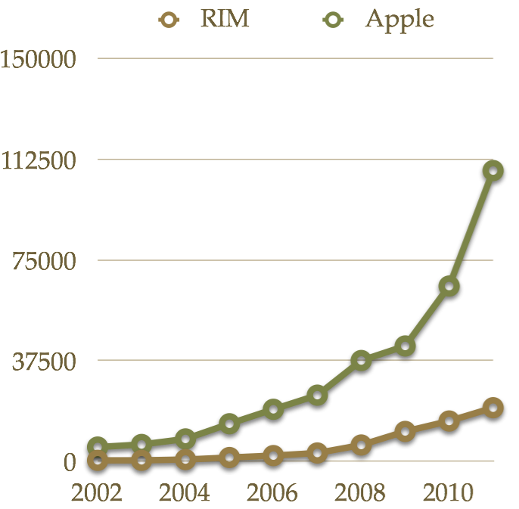
Revenues

Slide 9
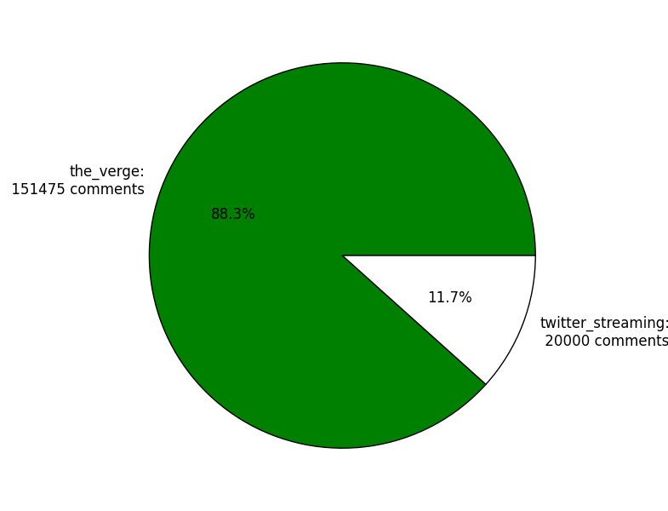
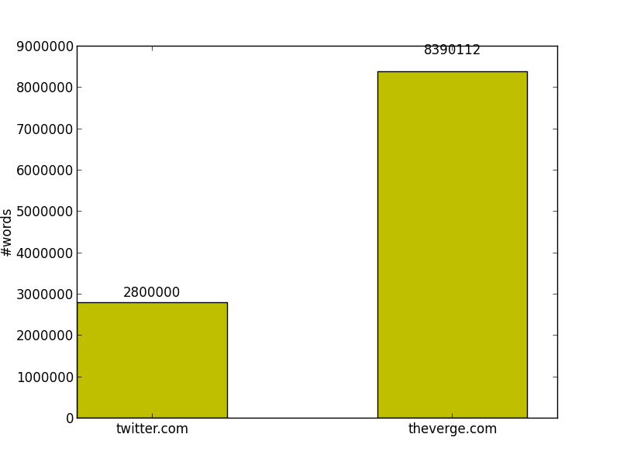
Data Statistics

Slide 10
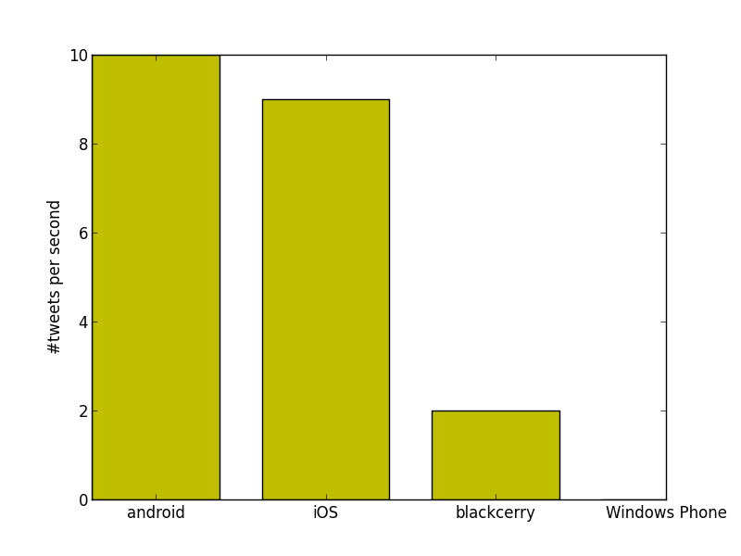
Tweets per second (Twitter)

Slide 11
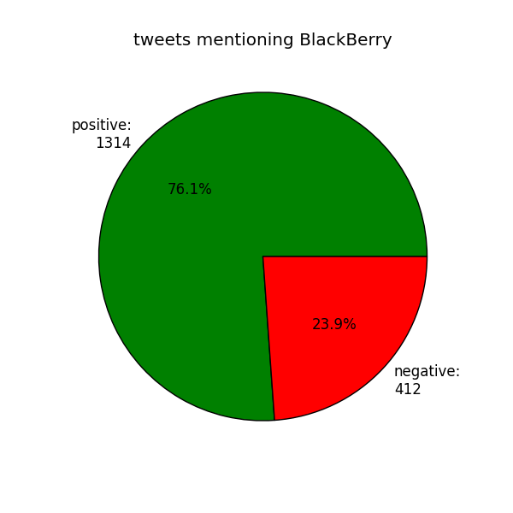
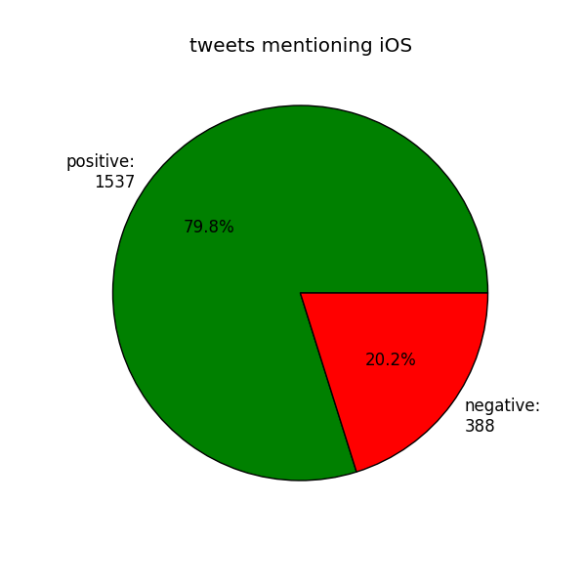
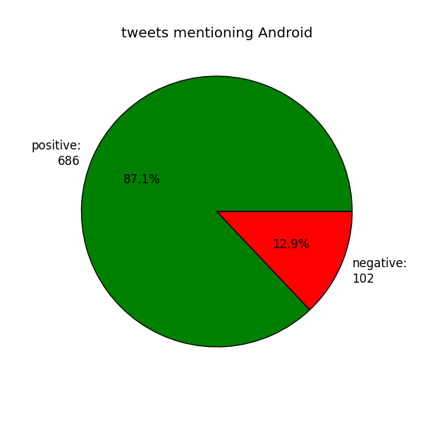
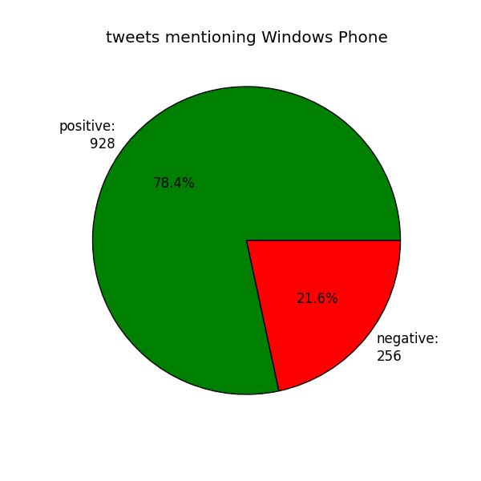
Specific Trends (Twitter)

Slide 12
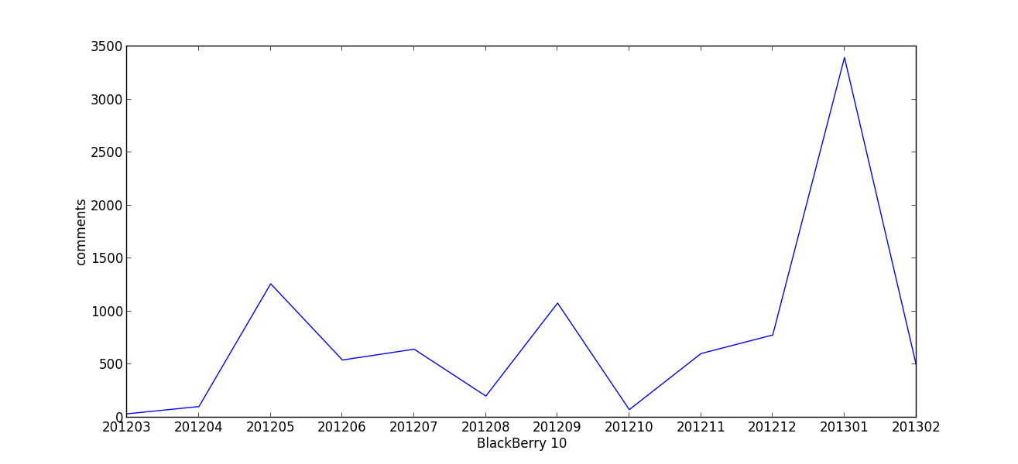
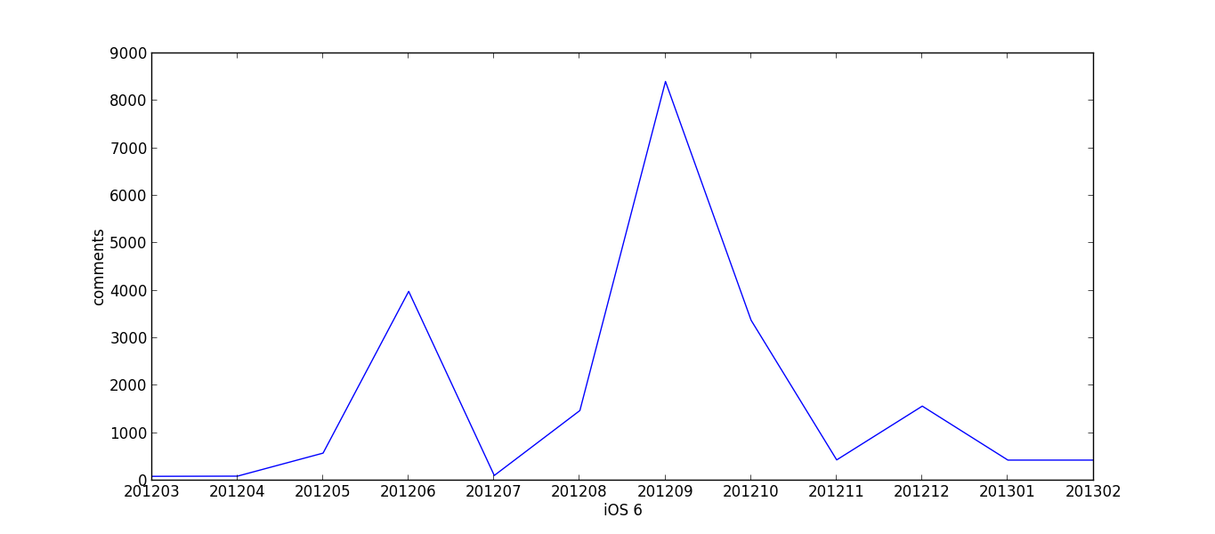
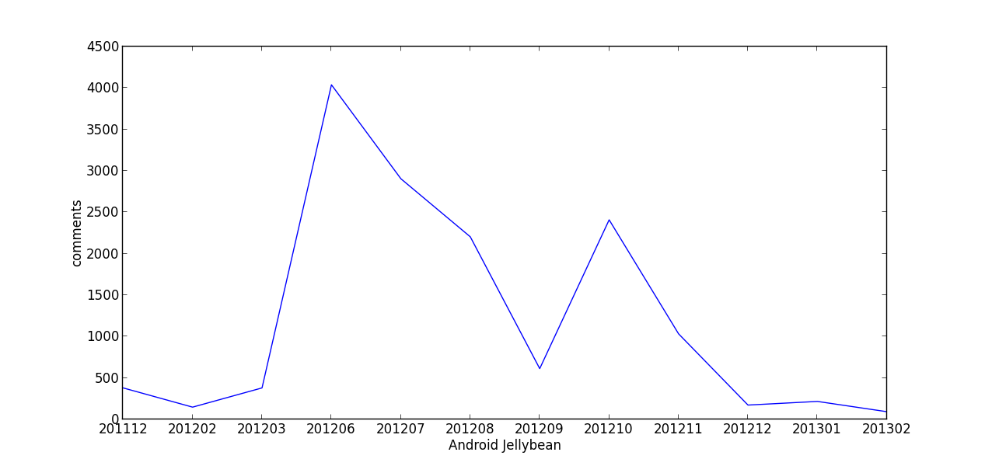
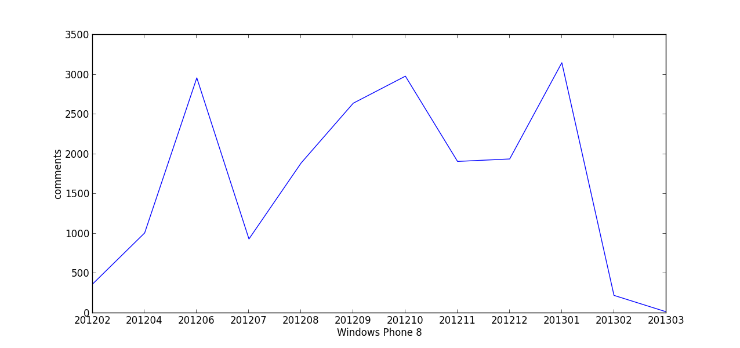
Trends in Comments (TheVerge)

Slide 13
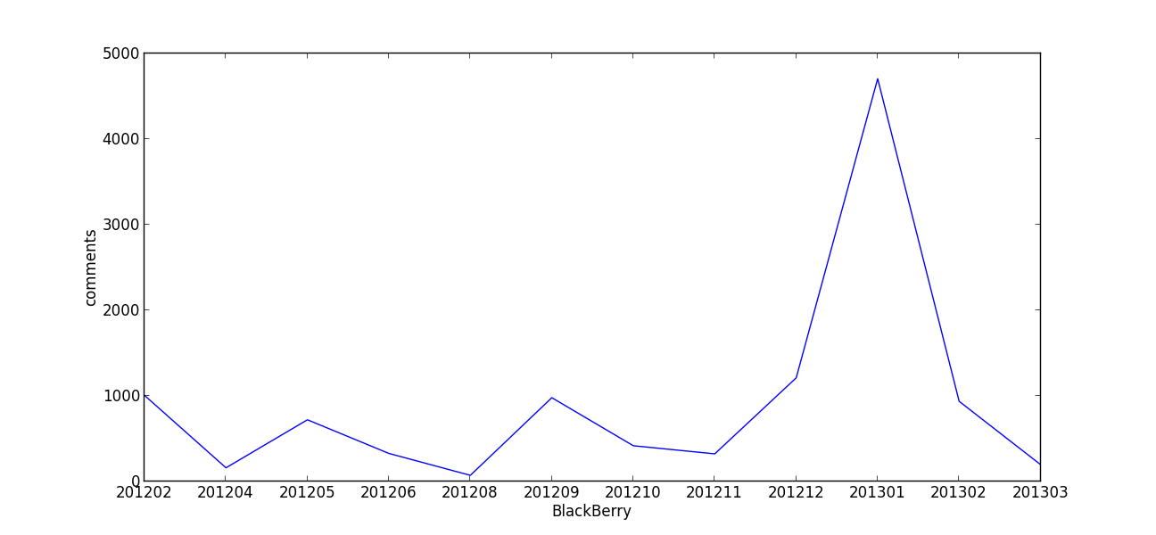
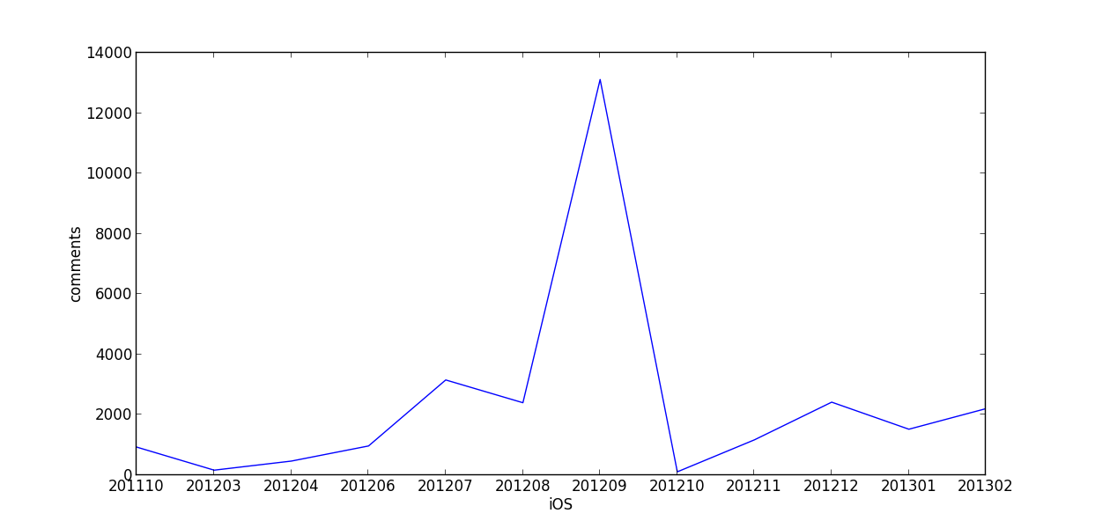
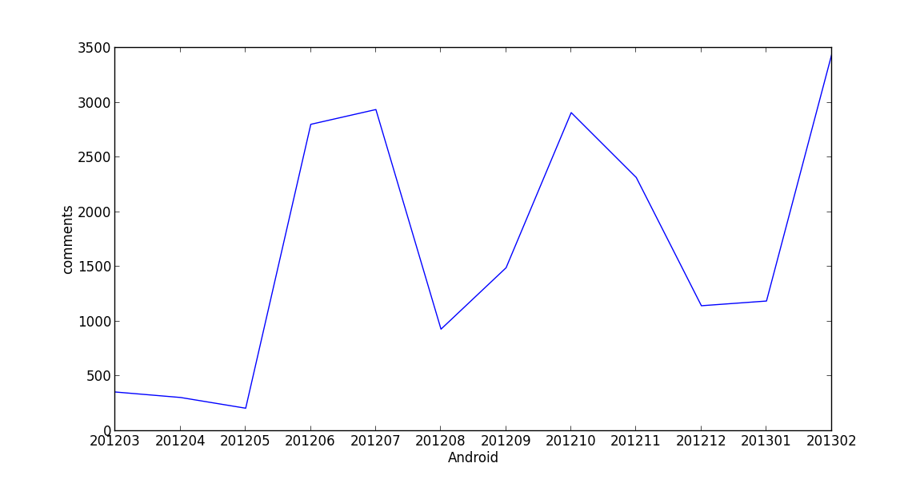
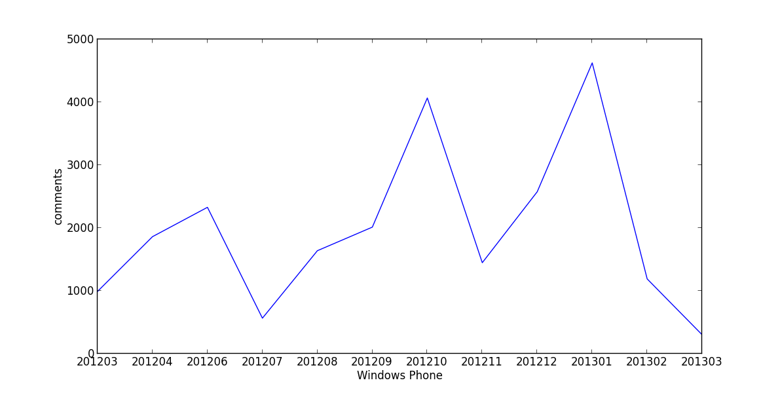
General Trends (TheVerge)

Slide 14
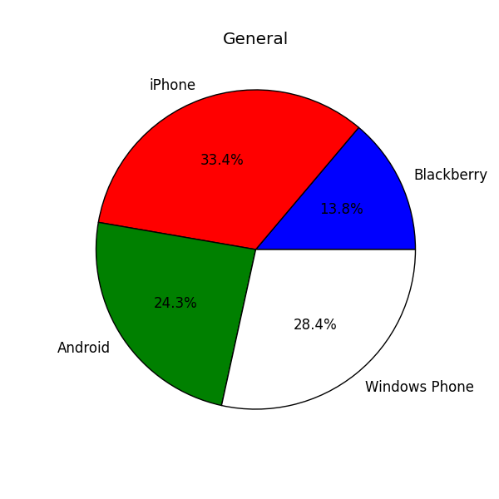
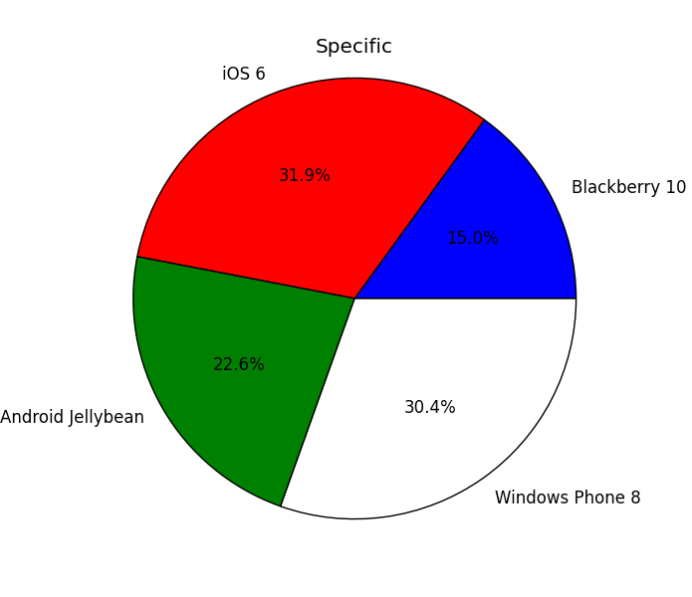
Total Comments (TheVerge)

Slide 15
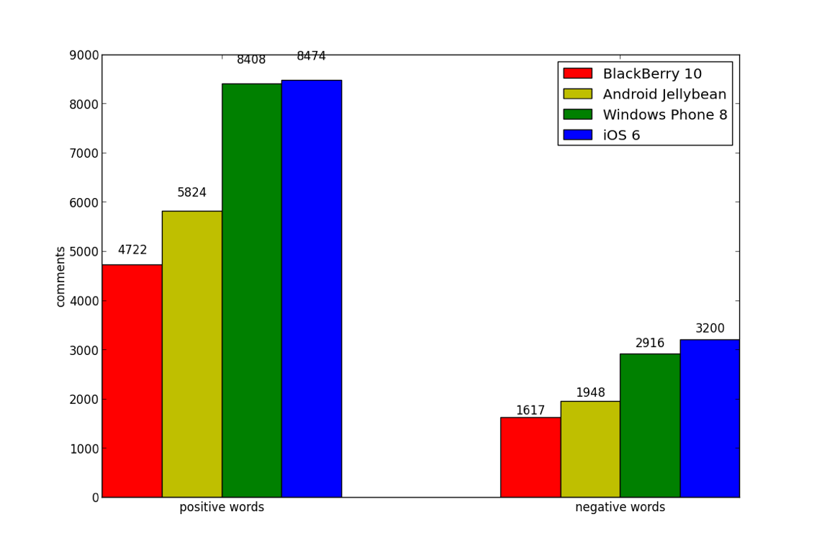
Negative Positive (TheVerge)

Slide 16
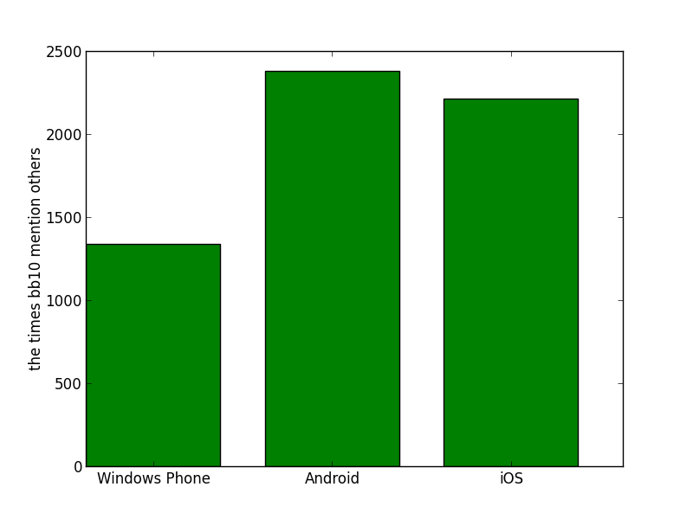
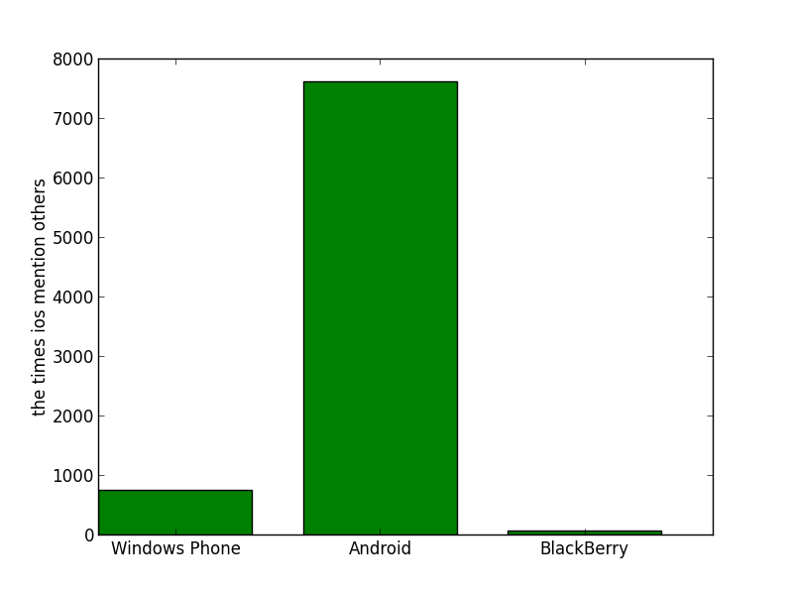
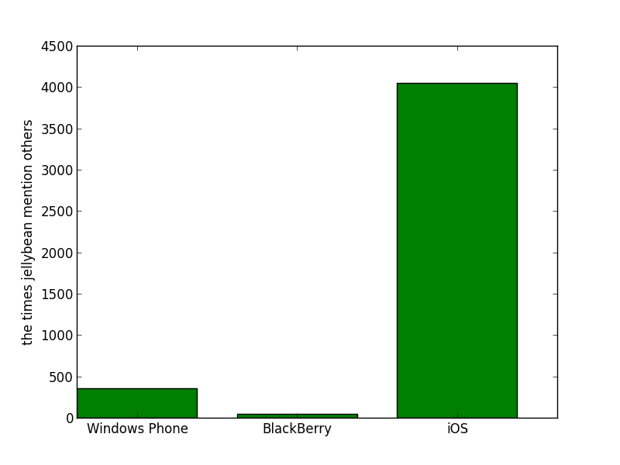
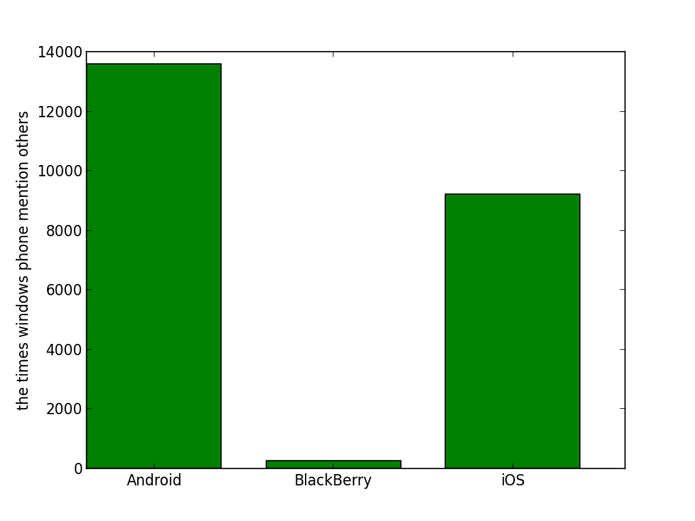
Mention of Others (TheVerge)
BlackBerry 10
iOS 6
Android JellyBean
Windows Phone 8

Slide 17
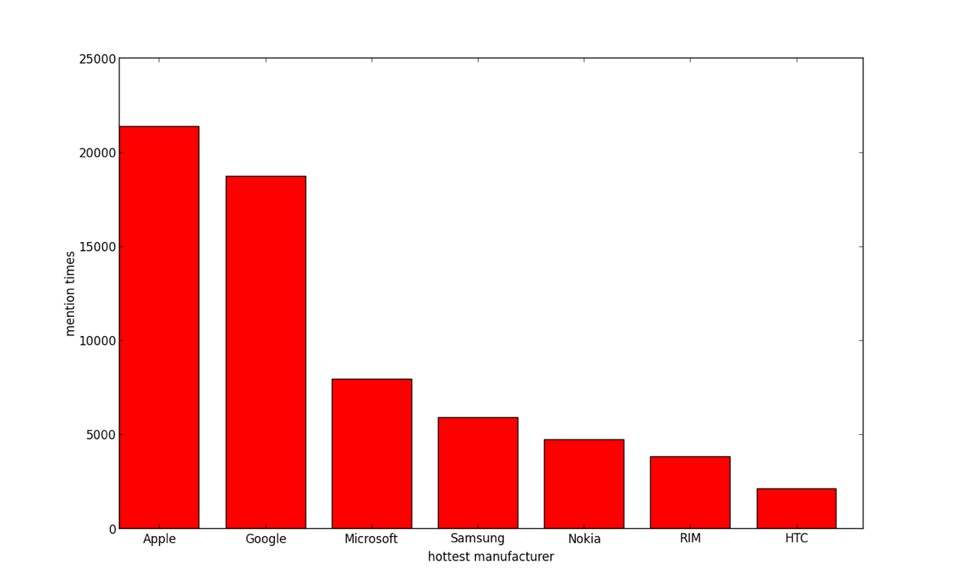
Popular Brand

Slide 18
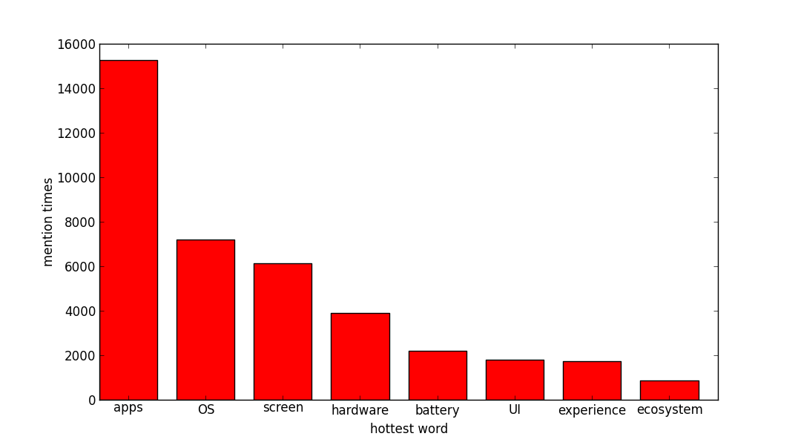
Popular Service

Slide 19
Conclusion
Delay in launching modern OS.
Comparisons with other operating systems.
More apps, better features, better ecosystem.
Focus on general public and not just corporate customers.
BlackBerry 10 is a start in the right direction but a long path to cover.

